Slide 1
Smart Water Networks
Design
Abhijith Madhav
Kumudini Kakwani

Slide 2
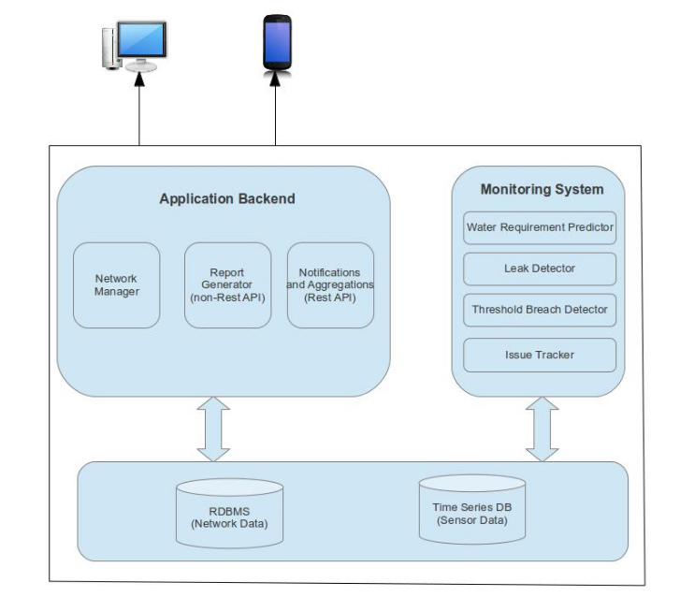
High Level Architecture

Slide 3
Design Highlights
Database design
Android application UI design
Application backend design

Slide 4
Database Design
Modeling the water network
  Water network – Nodes and Edges
  Why RDBMS?
  EAV design
  Aggregations
  Representing aggregation hierarchy
Storing sensor data
  Why time series database?

Slide 5
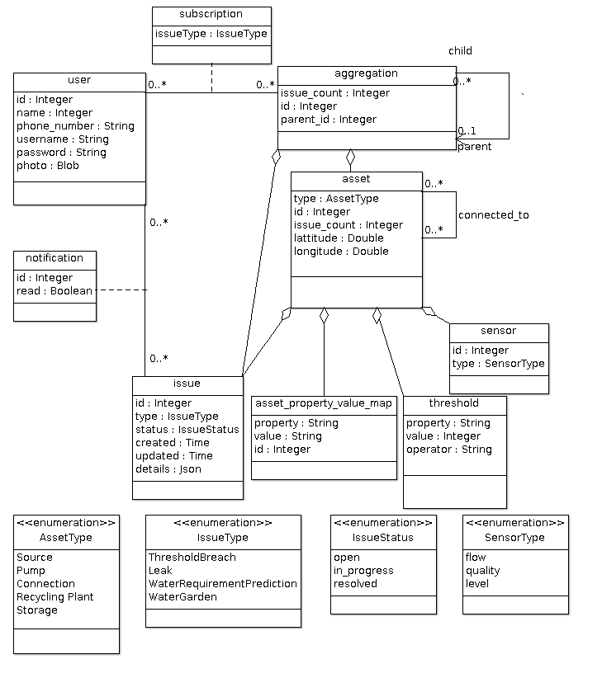
Database Design

Slide 6
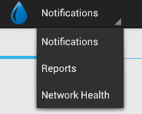
Android Application UI Design
Why tabbed view?
Polling server for notifications
- How often?
- Cache or not?

Slide 7
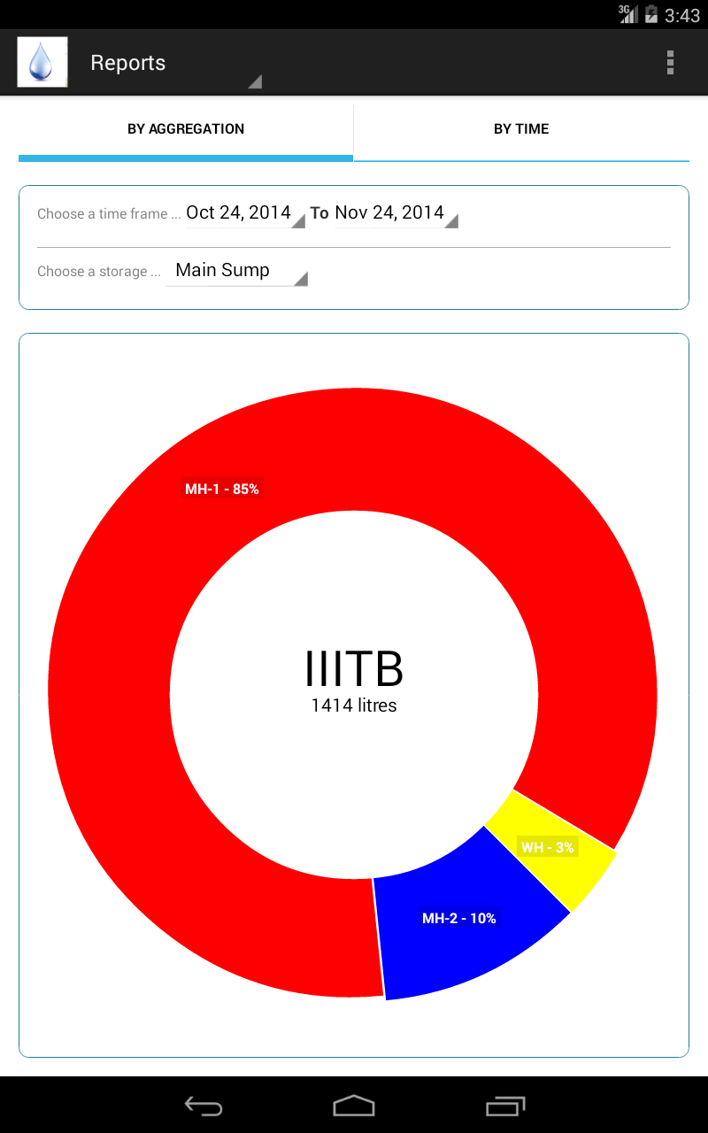
Android Application UI Design
Implications of using tabbed view
- Nested Fragments
- Difficulty in back navigation
- Communication between nested fragments on events

Slide 8
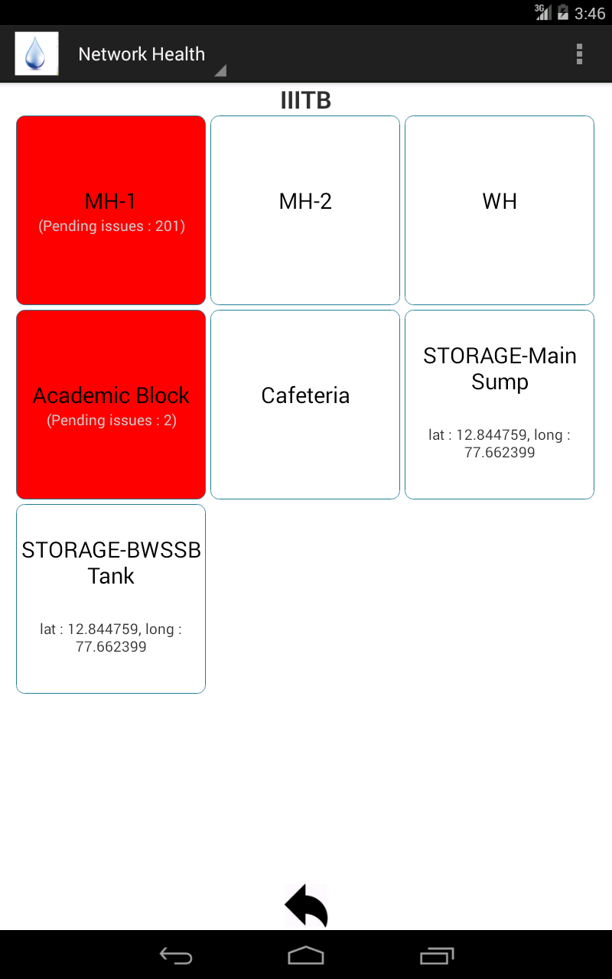
Android Application UI Design
Heirarchical view of water network
- Grid View
- Can be traversed up and down the heirarchy

Slide 9
Application Backend Design
REST API
  Notifications
  Aggregations
Non-REST API
  What do we mean by non-REST?
  Water usage breakup
  Water trends
  Can this be restified?
Monitoring system
  Why?
  Monitors breaches in thresholds set for sensors
  Runs various algorithms on a continous basis and generate appropriate issues and notifications
    Leak detection
    Water requirement prediction

Slide 10
Questions?

